Slide 1
CHAPTER 4
DISCRETE SYSTEM SIMULATION
4. Discrete System Simulation (8 hrs)
4.1 Discrete system simulation
4.2 Representation of time
4.3 Generation of arrival patterns
4.4 Simulation of telephone system
4.5 Gathering statistics
4.6 Counters and summary statistics
4.7 Measuring Utilization and Occupancy
4.8 Recording distribution and transit time
4.9 Discrete simulation languages

Slide 2
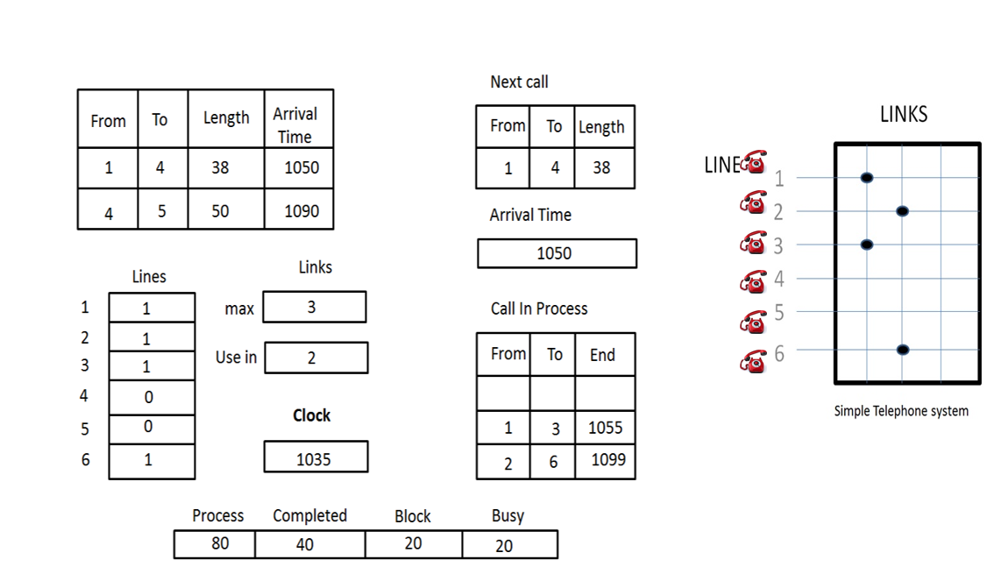

Slide 3
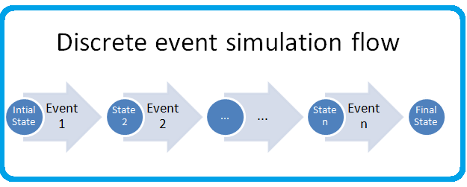
DISCRETE SYSTEM SIMULATION
Discrete Events
A simulation process will take the system model through a series of states.
We can describe the state of a system at a given instant, since the model of a system has a set of numbers to represent the state of a system.

Slide 4
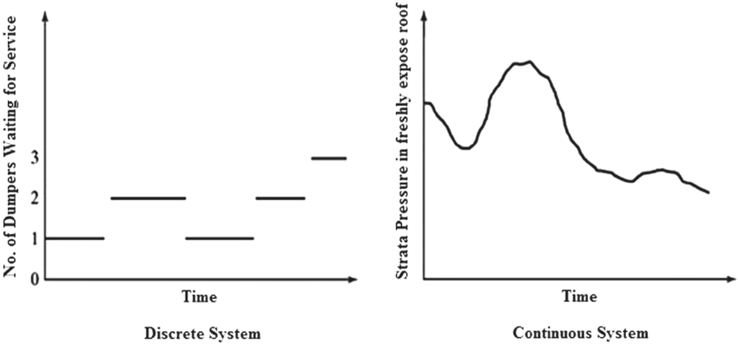
Discrete Events
A number that is used to represent some aspect of some system states is called a state descriptor.
As the simulation proceeds, the state descriptor changes their values.
Discrete event can be defined as a set of circumstances that cause an instantaneous change in one or more state descriptors of the system.

Slide 5
Discrete Events
Discrete event simulation concerns the modelling of the system as it evolves over time by a representation in which state variable changes instantaneously or at separate points in time.
It is also necessary that changes must be made sequentially.
So, a system simulation must contain a number representing time.
The simulation proceeds by executing all the changes to the system descriptors associated with each event, as the event occurs in chronological order.

Slide 6
Representation of Time
It refers to numbers that record the passage of time.
It is usually set to zero at the beginning of a simulation and subsequently indicates how many units of simulated time have passed since the beginning of the simulation.

Slide 7
Simulation Time / Time Advance Mechanism
Discrete event simulation concerns the modelling of the system as it evolves over time by a representation in which state variable changes instantaneously at separate points in time.
These points in time are the ones at which an event occurs. Event is an instantaneous occurrence that may change the state of the system.
It is necessary to keep track of the current value of the simulated time as the simulation proceeds and also we need a mechanism to advance simulated time from one value to another.

Slide 8
Simulation Time / Time Advance Mechanism
This is represented through simulation clock.
Simulation clock refers to the integrated clock time. Note that it is not the time that the computer has taken to carry out the simulation.
The simulation clock helps represent the dynamics of a system as if it were happening in real life, regardless of how fast or slow the computer calculates it. It's a vital abstraction in simulation to keep events in proper sequence and timing.

Slide 9
Simulation Time / Time Advance Mechanism
There are two basic methods used to update clock time:
i) Event Oriented Method [Next Time Advance Mechanism]
ii) Interval Oriented Method [Fixed Time Advance Mechanism]

Slide 10
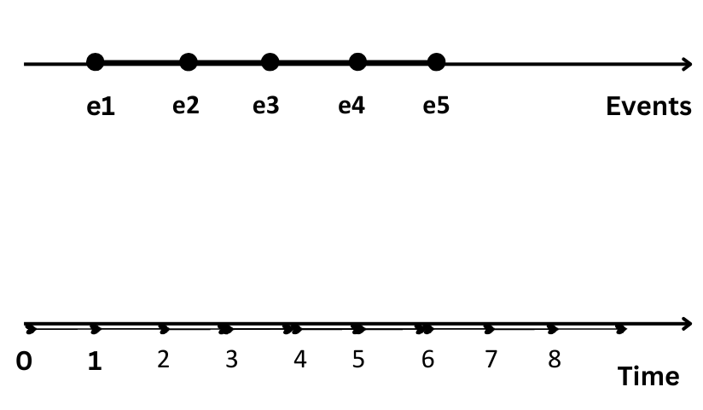
Simulation Time / Time Advance Mechanism
i) Event Oriented Method [Next Time Advance Mechanism]
In this method, the clock is advanced to the time at which the next event likely occurs.
In the above figure, we see that events e1, e2, e3, e4 occur at times 1, 2, 4, and 6 time units respectively.

Slide 11
Simulation Time / Time Advance Mechanism
With the next time advance mechanism, the simulation clock is initialized at zero initially.
A simulation clock is then advanced to the time of near-happening events at which point the state of the system is updated.
Clocks jump from one event time to the next and doesn't exist for time between successive events.
Discrete system simulation is usually carried out by using the event-oriented method.

Slide 12
Simulation Time / Time Advance Mechanism
ii) Interval Oriented Method [Fixed Time Advance Mechanism]
In this method, the clock is advanced by small uniform intervals of time and determines at each interval whether an event is due to occur at that time.
e0 e1 e2 e3 e4 e5
0 - 1 - 2 - 3 - 4 - 5 - 6 - 7 - 8 - 9 - 10 (Time)
In the above figure, we see that events e1, e2, e3, e4 occur at times 0, 2, 4, 6, 8, and 10 time units respectively.

Slide 13
Interval Oriented Method [Fixed Time Advance Mechanism]
With a fixed-time interval mechanism, the simulation clock is incremented with a small interval Δt (here 2), whether the event is occurred or not, we look at events at Δt to update the state of the system.
It is a very simple method to implement but not an accurate realization of occurrence of events.
Continuous system simulation normally uses the interval-oriented method.

Slide 14
An event-oriented program will detect discrete changes and can therefore simulate a discrete system.
An interval-oriented program can follow continuous changes by artificially introducing events that occur at regular time intervals and can therefore simulate a continuous system.

Slide 15
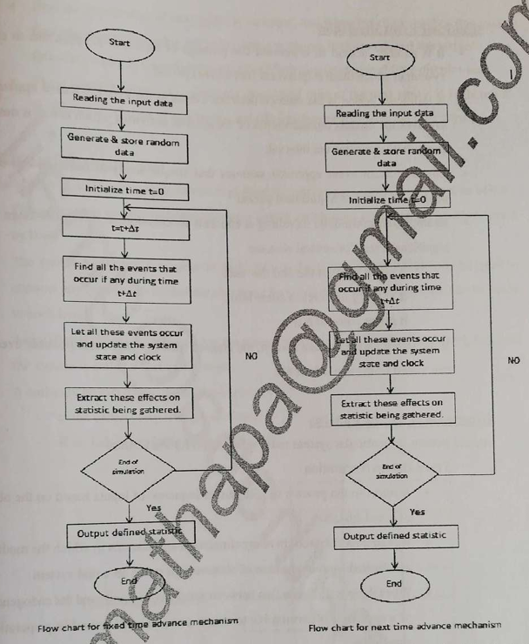

Slide 16
An event oriented program will detect discrete changes and can therefore simulate discrete system.
An interval oriented program can be made to follow continious changes by artificially introducing events that occours at regular time interval and can therefore simulate continious system.

Slide 17
Significant Event Simulation
It is another method to represent the passage of time and is applicable to continuous systems in which there is a quiescent (not active) period.
A quiescent period is the interval between events in the event-oriented approach, but it involves the models' representation of the system activities, which create a notice of the event that terminates the interval.
The significant event approach assumes that a simple analytic function can be used to project the value of a quiescent period.

Slide 18
Significant Event Simulation....cont..
Example: An automobile traveling at constant acceleration might result in a significant event for several reasons:
It might reach the end of the road.
Its velocity might reach some limit.
It might come to rest.
If the initial conditions are known, the elapsed time for each of these possible events can be calculated from a simple formula.

Slide 19
Generation of Arrival Patterns Arrival pattern for a particular system must be specified for simulation.
i. Trace Driven Simulation
It refers to the process of gathering a sequence of inputs based on the observation of a real system.
It is an important tool in many simulation applications where the model’s inputs are derived from observations made on a real system.
When there is no interaction between exogenous arrivals and endogenous events of a system, it is permissible to create a sequence of arrivals in preparation for the simulation.
Usually, the simulation proceeds by creating new arrivals as they are needed.

Slide 20
Trace Driven Simulation...Cont..
Trace Driven Simulation involves using pre-recorded data (a "trace") from a real-world system to simulate the behavior of a system or model.
It helps study how a system reacts to real-world inputs and provides insights without needing to test on the actual system.
A sequence of inputs or events from a real system (trace) is fed into the simulation model. The model then behaves as though those inputs occurred in real time.

Slide 21
Trace Driven Simulation Example:
Imagine a network server that handles client requests.
You first observe the server for a day and record the arrival times of requests and their sizes (this is your trace).
You use this trace data to simulate the server in a lab to test how it would perform under different conditions, like a faster or slower processor.
This avoids the need to experiment on the live server, reducing the risk of disruption.

Slide 22
Bootstrapping
Bootstrapping usually refers to a self-starting process that is supposed to proceed without external input.
It is the process of making one entity create its successor.
Here, the arrival time of the next entity is recorded, and when the clock reaches this event time, the event of entering the entity into the system is executed.
The arrival of the following entity is immediately calculated from the inter-arrival time distribution.
These methods require keeping only the arrival time of the next entity. It is, therefore, the preferred method of generating arrivals for computer simulation programs.

Slide 23
Bootstrapping....cont..
Bootstrapping refers to a self-starting process where the system generates new events or arrivals based on its own rules without relying on external inputs.
It is useful for initializing or running a system where external input isn’t immediately available.
Each entity (like a task or an event) creates its successor. For example, the system generates the time for the next event based on probabilities or a pre-defined distribution.

Slide 24
Bootstrapping...cont.. Example:
Consider a restaurant simulation where customers arrive at random intervals.
Instead of observing actual arrival times (like in Trace Driven Simulation), you program the simulation to create arrivals using a random distribution (e.g., exponential distribution for inter-arrival times).
When one customer arrives, the system calculates when the next customer will arrive, based on the distribution.
This keeps the simulation running without needing real-world data.

Slide 25
Comparison :
Feature | Trace Driven Simulation | Bootstrapping
Input Source | Real-world trace data (observations). | Self-generated using statistical methods.
Use Case | Testing behavior against real-world patterns. | Running a system without real-world inputs.
Example | Simulating network traffic using actual logs. | Simulating random customer arrivals.

Slide 26
Use Trace Driven Simulation when you want to study or reproduce behavior based on observed real-world data.
Use Bootstrapping when no real-world data is available, and you want the system to self-generate new events or arrivals based on rules or distributions.

Slide 27
Simulation of Telephone System
The simulation of a discrete system can be explained by simulating a telephone system as below:

Slide 28
Objectives
Process a given number of calls and determine what proportions are
successfully completed
blocked or
found to be busy calls

Slide 29
Objectives
The system has a number of telephones (8 are shown) connected to a switchboard by lines.
The switchboard has a number of links which can be used to connect any two lines, subject to the condition that only one connection at a time can be made to each line.
The system is lost call system.
i) A call is lost, if the called party is engaged, then it is a busy call.
ii) A call may be lost if no link is available, it is blocked call.

Slide 30
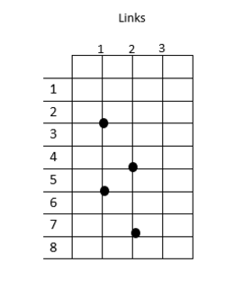

Slide 31
Situation
Each call is a separate entity having attributes
a) Source
b) Destination
c) Length, and
d) the time at which call finished
0 represents Free
1 represents Busy
To keep track of event, a number representing clock time is included. At present 1035(time unit)
To generate the arrival of call, a record is kept of the time the next call is due to arrive.
The set of numbers within the main box of figure records the state of the system at time 1027.
There are two activities causing events:
i) New calls arrive
ii) Existing calls vanish

Slide 32
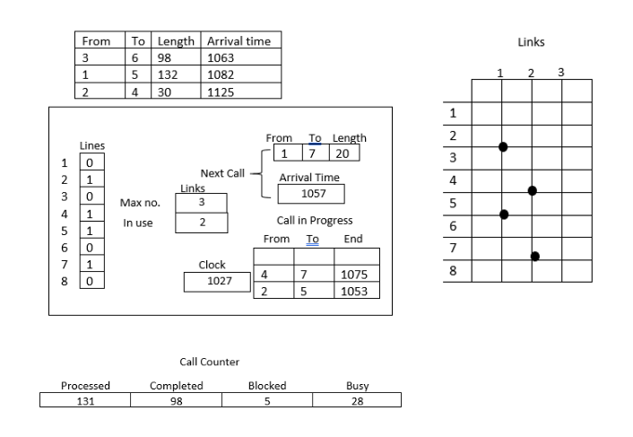

Slide 33
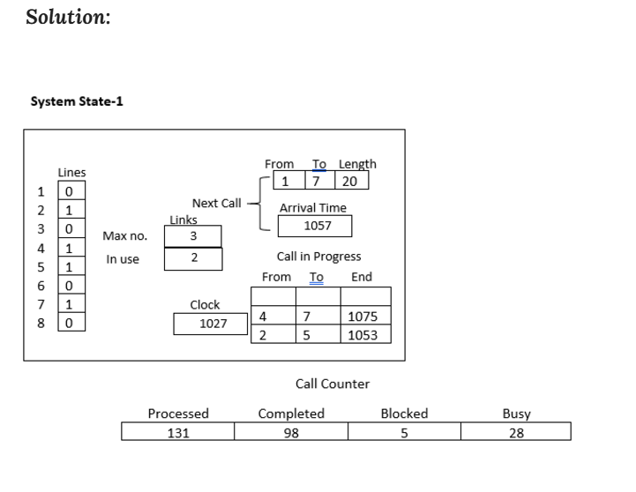

Slide 34
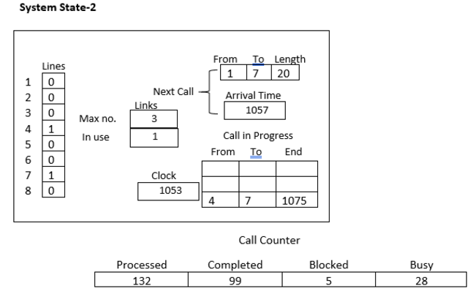

Slide 35
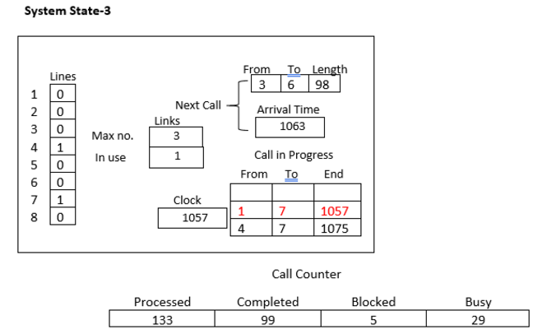

Slide 36
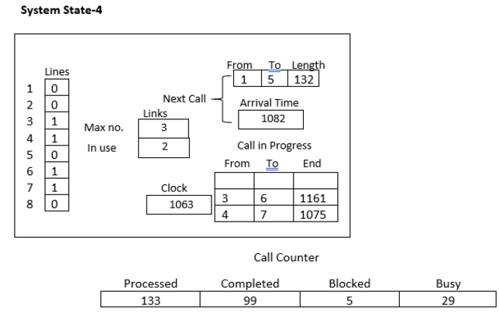

Slide 37
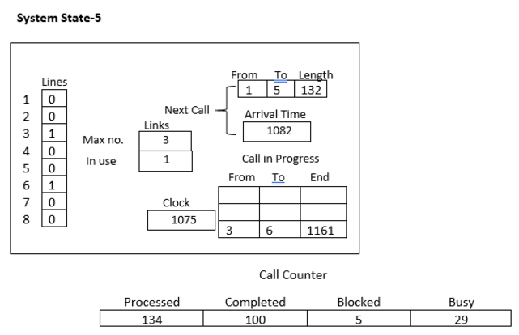

Slide 38
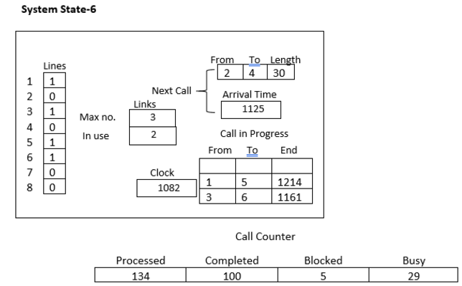

Slide 39
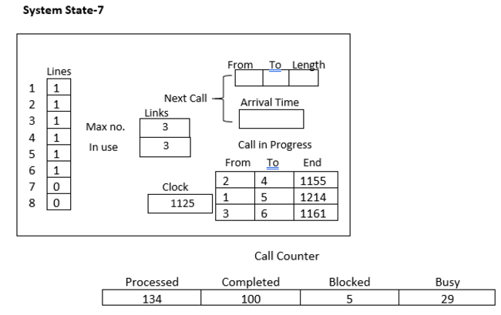

Slide 40
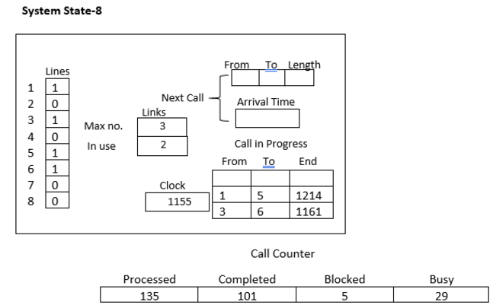

Slide 41
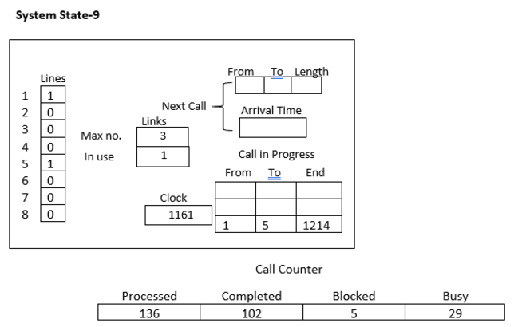

Slide 42
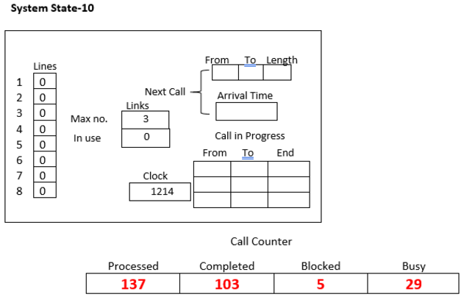

Slide 43
Termination of simulation
After processing a given number of calls, or
Until a certain time has elapsed.

Slide 44
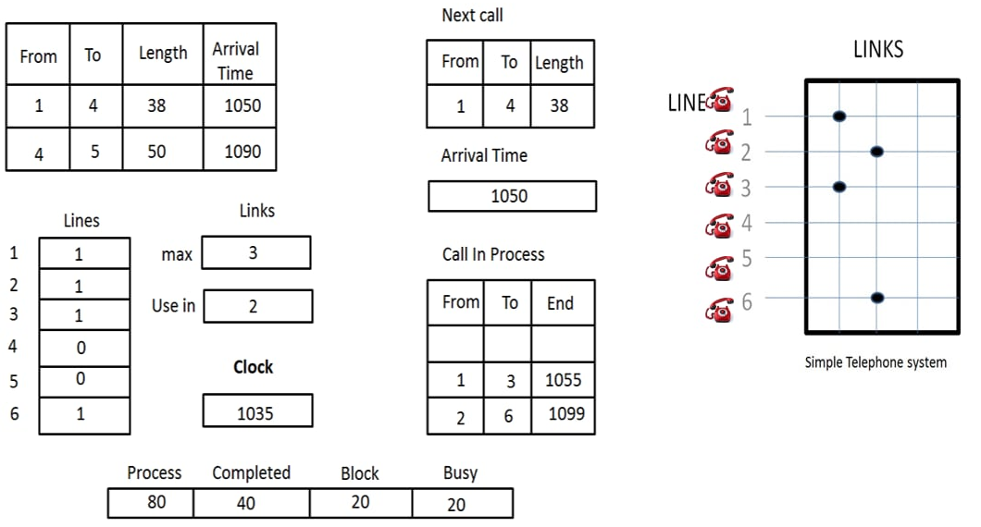
Assignment 2
Process a given number of calls and determine what proportions are
successfully completed
blocked or
found to be busy calls

Slide 45
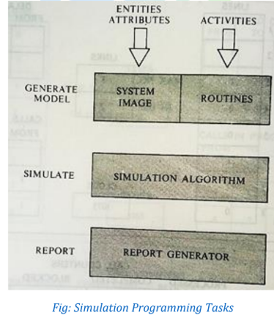
Simulation Programming Task
There are mainly three tasks to be performed in simulation programming. They are :

Slide 46
Simulation Programming Task..cont..
i) Generating a Model:
The first step in simulation programming is creating a model and initializing it.
A set of numbers (called the system image) is generated based on the system's description to represent its state.
The system's activities are represented as routines that trigger discrete events, altering the system image accordingly.

Slide 47
Simulation Programming Task..cont..
ii) Simulation:
After the model is generated, the next step is to program procedures that simulate the actions of the system.
This process is termed the simulation algorithm, which handles the cycle of actions to execute the simulation effectively.

Slide 48
Simulation Programming Task..cont..
iii) Generating a Report:
Purpose:
After programming and running the simulation algorithm, the next task is to generate an output report.
The report summarizes statistics (data) gathered during the simulation.
General Flow of Control:
Top of the Flow: Start with generating a model (this is done only once).
Bottom of the Flow: Generate the final report (executed at the end of the simulation).

Slide 49
Steps in the Simulation Algorithm:
The simulation involves a repetitive cycle of five key steps:
Find the next potential event to occur: Identify what will happen next in the system.
Select an activity: Choose the appropriate routine or action based on the event.
Test if the event can be executed: Check conditions to ensure the event is feasible.
Change the system image: Update the system's state based on the event's outcome.
Gather statistics: Collect data for analysis and reportin
End Goal:
Compile all collected data into an organized report, which provides insights into the system's performance, bottlenecks, or other critical aspects.

Slide 50
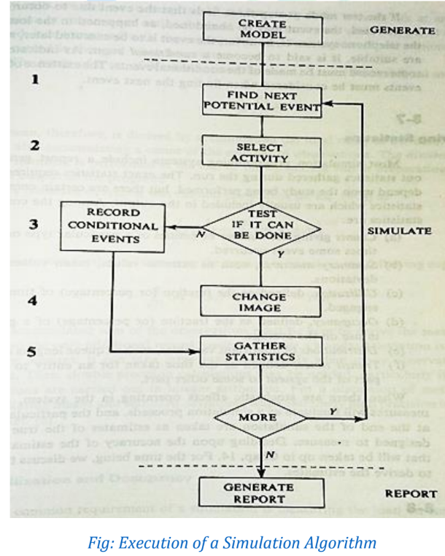

Slide 51
Gathering Statistics:
In simulation programming, statistics are collected during the run and processed by a report generator. These statistics help evaluate system performance and behavior. The type of statistics depends on the study's purpose.

Slide 52
Commonly Required Statistics:
Counts:
Tracks the number of entities at a specific point or the frequency of events.
Example: Number of planes that landed in the simulation.
Summary Measures:
Includes statistical measures like extreme values, mean values, and standard deviation.
Example: Average waiting time in a queue.
Utilization:
Measures the percentage of time a resource (e.g., a runway, a server) is in use.
Example: Runway utilization = (time runway is busy / total simulation time) × 100.

Slide 53
Occupancy:
Calculates the average percentage of a group of entities being used.
Example: Percentage of airport gates occupied at any given time.
Distribution:
Records the distribution of key variables like queue lengths or waiting times.
Example: Distribution of planes' waiting times for a free runway.
Transit Time:
Measures the time taken for an entity to move from one part of the system to another.
Example: Time taken for a plane to move from the holding area to the runway.

Slide 54
Example Application: Hospital Emergency Room
In a simulation of an emergency room:
Counts: Number of patients treated.
Summary Measures: Average wait time and standard deviation.
Utilization: Percentage of time doctors or nurses are busy.
Occupancy: Average occupancy rate of beds.
Distribution: Distribution of patient arrival times.
Transit Time: Time taken for a patient to move through triage, treatment, and discharge.
statistics help optimize resource allocation, and improve overall system performance.

Slide 55
Counter and Summary Statistics:
The counter which is the basis for most statistics are used to accumulate totals and to record current values of some level in the system.
For example, in the simulation of the telephone system, the counter is used to record the total number of the lost call, busy call, and to keep track of how many links were in use at any time.
Whenever a new value of a count is established, it is compared with the record of the current maximum or minimum, and the record is changed when necessary.
The accumulator sum of observation must be kept to derive the mean value and standard deviation as below:

Slide 56
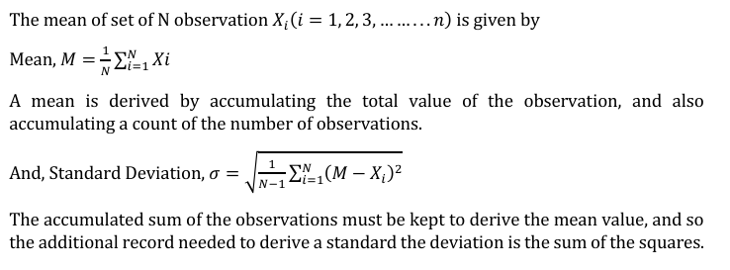
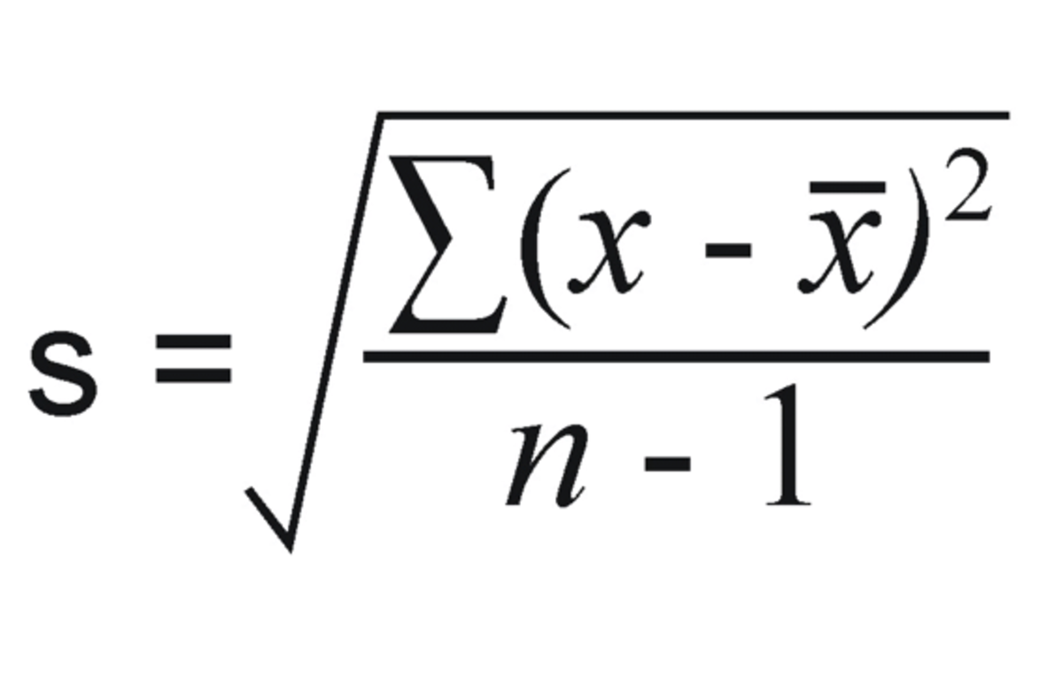
Counter and Summary Statistics:

Slide 57
Measuring Utilization & Occupancy:
The common requirement of simulation is measuring the load on some entity such as an item or the equipment.
To measure the load on some entity such as an item of equipment, the simplest way is to determine what fraction/percentage of the time, the item as engaged during the simulation.
Measuring those statistics is referred to as the utilization of that equipment.

Slide 58
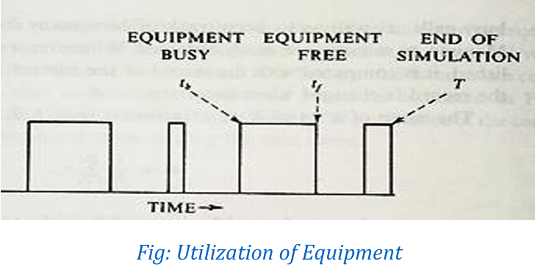
Measuring Utilization & Occupancy...cont..
The time history of an equipment usage might appear as shown in the figure below:

Slide 59
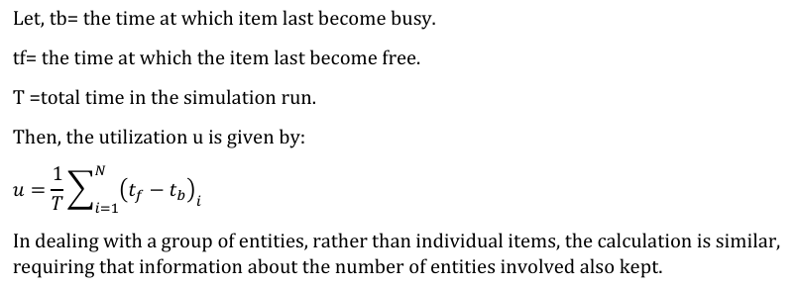

Slide 60
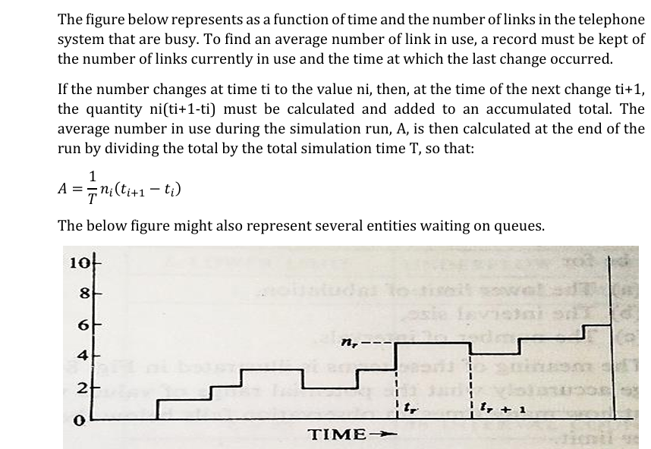

Slide 61
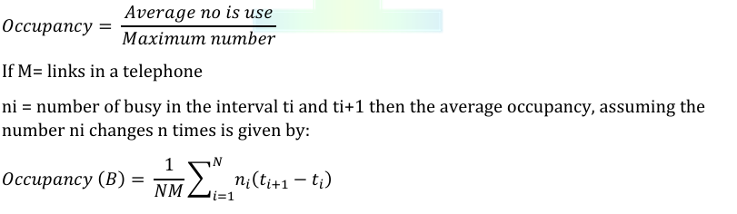
If there is an upper limit on the number of entities, as there was a limit on several links in the telephone system then the occupancy is defined as the ratio of the average number in use to the maximum number.

Slide 62
Recording Distribution & Transit Time:
To determine the distribution of a variable it requires counting the number of times the value of the variable fall within specific interval.
For this purpose, a table with location to define the internal and to accumulate the count has to be maintained.
When an observation is made, the value is compared with the defined intervals and the appropriate must be incremented by one.
The definition of a destination table required specification for the lower limit of the tabulation, the interval size and the number of intervals. Normally, the tabulation interval sizes are uniform.

Slide 63
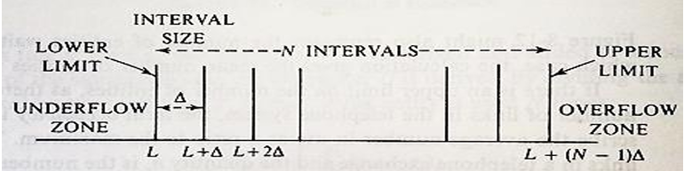
Generally, it is required to keep count the number of time and observation falls below the lower limit and beyond the upper limit rather than to obtain accurately the potential range of valuation.
To determine the mean and standard deviation, it will be required to accumulate number of observation (Xi) and the sum of squares ∑(𝑋𝑖)2. For each observation Xi,

Slide 64
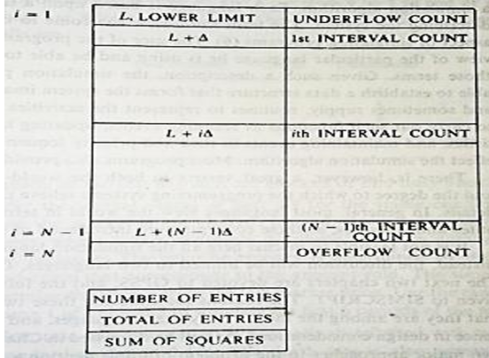
One is added to appropriate counter
Xi is added to the sum, ∑(𝑋𝑖) ➢
(Xi)2 is added to the sum, ∑(𝑋𝑖)2

Slide 65
Since values of observation are matched to an interval the derived destination is an approximation.
However, note that the mean and standard deviation will be accurate within the accuracy limit of the computer even if some observations fall outside the table
limits.
The instances when the observations are made are determined by the native of the random variable being measured.

Slide 66
To understand this, consider the following two examples:
1. To measure the mean waiting time for a service, an observation must be taken as each entity starts to receive service so that the times at which the observations are tabulated are randomly spaced.
2. To measure the distribution of the number of entities waiting, observation should be taken at uniform interval time. The final output weight also expresses the data in another commercial form as required. For example, the cumulative distribution may be given or the distribution may be resolved to express the counts as a percentage of total observation. These results are calculated at the end of the simulation.

Slide 67
A clock is used in the manner of the time stamp to measure transit time. When an entity reaches a point from which a measurement of transit time is to start. A note of the time of arrival is made.
Later when the entity reaches the point, at which, the measured ends, a note of the clock time upon arrival is made and these two clock time noted are used to compute the elapsed time.

Slide 68
Discrete Simulation Languages:
To simplify a task of writing a discrete simulation program, several programming languages are sued. The two most commonly used are:
1. GPSS
2. SIMSCRIPT
These languages are used to describe a system and establish a system image and execute a simulation algorithm. Most programming also provides report generators. These languages also offer many convenient facilities such as,
a. Automatic generators of streams of pseudo-random numbers for any desired statistical destination.
b. Automatic data collection
c. Their statistical analysis and report generations
d. Automatic handling of queues, etc.

Slide 69
Also, a good simulation provides a nodded builder with the view of the world that next nodded building easier. Every discrete system simulation language must provide the concept and statement for:
a. Representing the state of a system at a single point in time (static modelling)
b. Moving a system from state to state (Dynamic modelling), &
c. Performing relevant task such as the random number of generation, data analysis and report generation.

Slide 70
Classification of Discrete System Simulation Languages:
1. Flowchart Oriented Languages:
2. Activity Oriented Languages:
3. Event Oriented Languages:
4. Process Oriented Languages:

